Slide 1
Entity Framework Core
Logging in EF Core

Slide 2
Lesson Objectives
Logging in .NET Core
Log Levels
Logging in EF Core

Slide 3
Logging in .NET Core
Section 1

Slide 4
.NET Extensions
.NET Extensions is an open-source, cross-platform set of APIs for commonly used programming patterns and utilities, such as dependency injection, logging, and app configuration.
Most APIs in this project are meant to work on many .NET platforms, such as .NET Core, .NET Framework, Xamarin, and other.
All the extensions are included under the Microsoft.Extensions namespace

Slide 5
Logging in .NET Core
Two important building blocks for implementing logging in a .NET Core based application:
Logging API
Logging Providers
The Logging API is included in the Microsoft.Extensions.Logging package.
The Logging API does not work as standalone. It works with one or more logging providers that store or display logs to a particular medium such as Console, Debug, TraceListeners, etc.

Slide 6
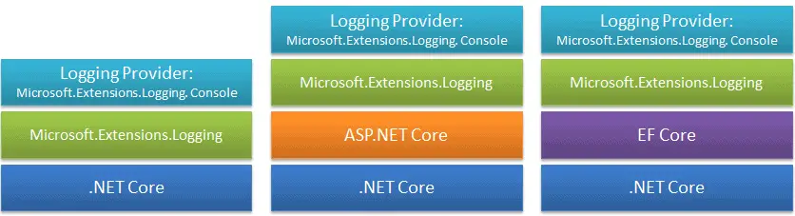
Logging in .NET Core
The logging API in Microsoft.Extensions.Logging works on the .NET Core based applications whether it is ASP.NET Core or EF Core.
Use the logging API with one or more logging providers to implement logging in any .NET Core based application.

Slide 7
Logging API

Slide 8
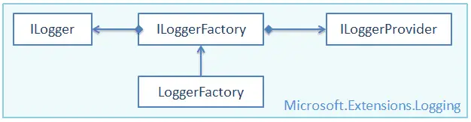
Logging API
Microsoft.Extensions.Logging includes the necessary classes and interfaces for logging.
The most important are the ILogger, ILoggerFactory, ILoggerProvider interfaces and the LoggerFactory class.

Slide 9
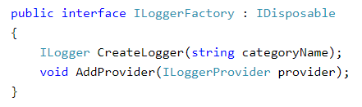
Logging API - ILoggerFactory
The ILoggerFactory is the factory interface for creating an appropriate ILogger type instance and also for adding the ILoggerProvider instance.
The Logging API includes the built-in LoggerFactory class that implements the ILoggerFactory interface.
We can use it to add an instance of type ILoggerProvider and to retrieve the ILogger instance for the specified category

Slide 10
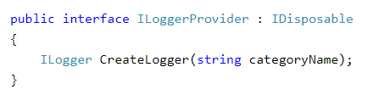
Logging API - ILoggerProvider
The ILoggerProvider manages and creates an appropriate logger, specified by the logging category.

Slide 11
Logging API - ILogger
The ILogger interface includes methods for logging to the underlying storage. There are many extension methods which make logging easy.
public interface ILogger {
void Log<TState>(
LogLevel logLevel,
EventId eventId,
TState state,
Exception exception,
Func<TState, Exception, string> formatter);
bool IsEnabled(LogLevel logLevel);
IDisposable BeginScope<TState>(TState state);
}

Slide 12
Logging Providers

Slide 13
A logging provider displays or stores logs to a particular medium such as:
a console,
a debugging event,
an event log,
a trace listener,
and others.
Microsoft provides various logging providers as NuGet packages.

Slide 14
Logging Provider's NuGet Package
Logging Provider's NuGet Package | Output Target
Microsoft.Extensions.Logging.Console | Console
Microsoft.Extensions.Logging.AzureAppServices | Azure App Services 'Diagnostics logs' and 'Log stream' features
Microsoft.Extensions.Logging.Debug | Debugger Monitor
Microsoft.Extensions.Logging.EventLog | Windows Event Log
Microsoft.Extensions.Logging.EventSource | EventSource/EventListener
Microsoft.Extensions.Logging.TraceSource | Trace Listener

Slide 15
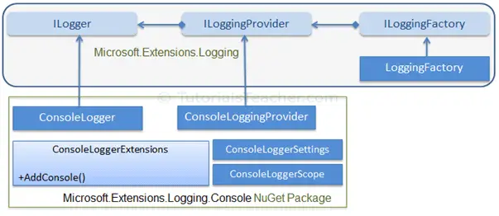
Console Logging Provider
The Microsoft.Extensions.Logging.Console package includes logging classes which send log output to the console.

Slide 16
Console Logging Provider
The ConsoleLogger implements ILogger, while the ConsoleLoggingProvider implements ILoggingProvider.
The ConsoleLoggerExtensions class includes extension method AddConsole(), which adds a console logger to the LoggerFactory

Slide 17
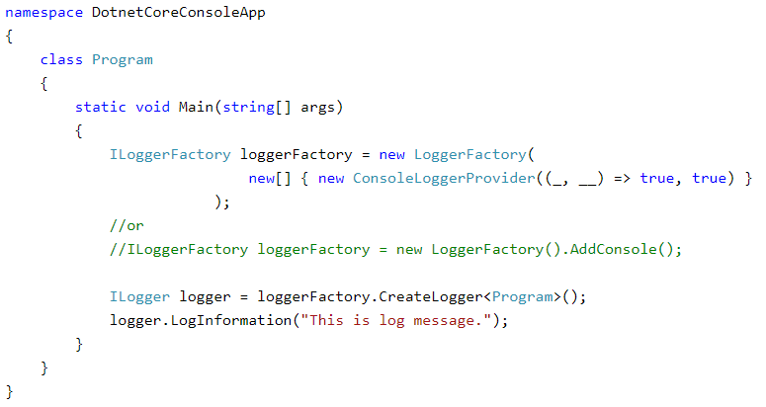
Console Logging Provider
Example (need to install a NuGet package of Microsoft.Extensions.Logging)
info: DotnetCoreConsoleApp.Program[0] This is log message.

Slide 18
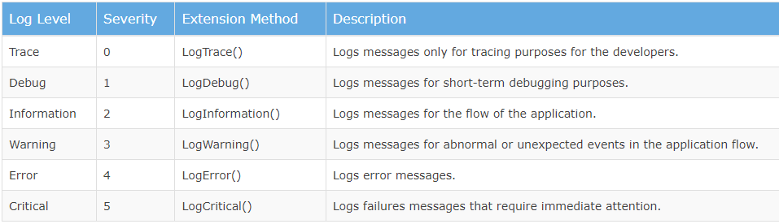
Log levels
Log levels indicate the importance or severity of log messages.
Built-in log providers include extension methods to indicate log levels.

Slide 19
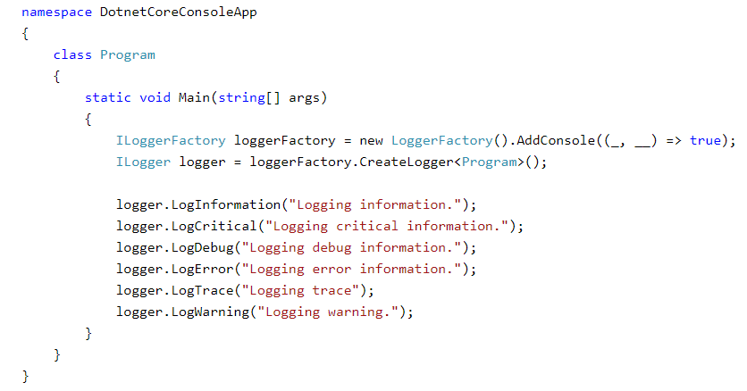
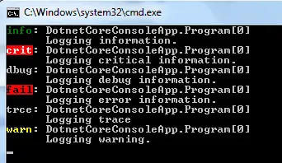
Log levels - Example

Slide 20
Logging in EF Core
Section 2

Slide 21
EF Core logging
EF Core logging automatically integrates with the logging mechanisms of .NET Core.
EF Core integrates with the .NET Core logging to log SQL and change tracking information to the various output targets.
First, install the Nuget package for logging provider and then tie up the DbContext to ILoggerFactory
PM> Install-Package Microsoft.Extensions.Logging.Console

Slide 22
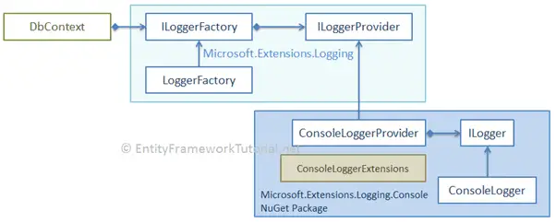
DbContext works with the logging API
DbContext works with the logging API and console logging provider

Slide 23
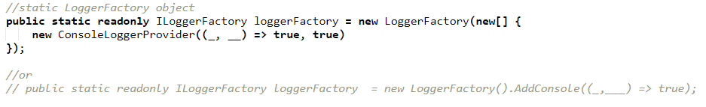
DbContext works with the logging API
After installing the console logger provider, we need to create a static/singleton instance of the LoggerFactory and then tie it with a DbContext.
By default, EF Core will not log sensitive data, such as filter parameter values. So, call the EnableSensitiveDataLogging() to log sensitive data.

Slide 24
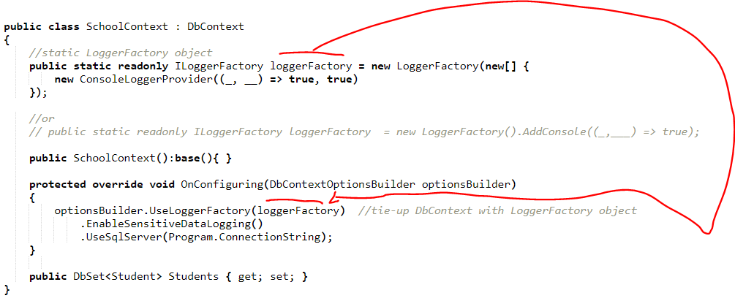
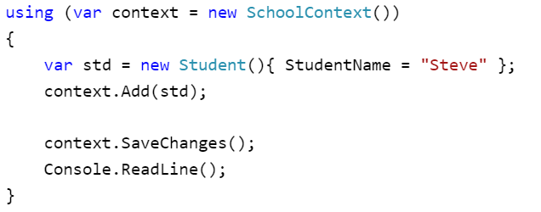
EF Core logging - Example

Slide 25

Thank you

